Slide 1

A LIBRARY MANAGEMENT SYSTEM PRESENTED BY: DREAM CRUSHER
JONY martin
Cse 063 07515
Abu rishad
Cse 063 07437
Abir hossian
Cse 063 07441

Slide 2
Information Gathering
Objectives
Construct meaningful interview questions
Understanding the client & organization’s view
Understanding the current system
Write effective questions to survey users about their work.
Creating data flow diagram

Slide 3
Information Gathering will be shown by three ways.
Interview
Questionnaires
Investigation

Slide 4
Interview Structure
Interview structure was pyramid type
start with a specific or open ended question
End with some general questions

Slide 5
Interview Question
01.Which people could use your library?
Mainly students or it can be educated people.
02.Is there any other library should connected to your library?
Not Concerned yet.
03.Should it need high privacy and security?
We just need a primary security.

Slide 6
Interview Question
04.How can social media be used to enhance library services?
Social media allows libraries to target the audience with tailored messages or can use Facebook and Twitter and Instagram.
05.What is the biggest challenge now faced in your library?
Problems differ from library to library. There are various dimensions and factors associated with it. It depends upon the situation and other reasons.

Slide 7
Interview Question
06.What are the inputs and outputs in an e library system?
Inputs:
Book details
Borrower details
Date & time borrow
Outputs
Date & time borrower can renew the book online
Date & time borrower needs to physically return the book for renewal / return
Penalty payment to collect from the overdue borrower

Slide 8
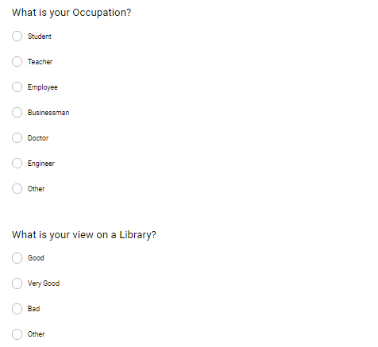
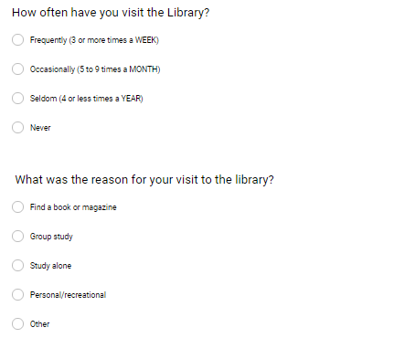
Questionnaires

Slide 9
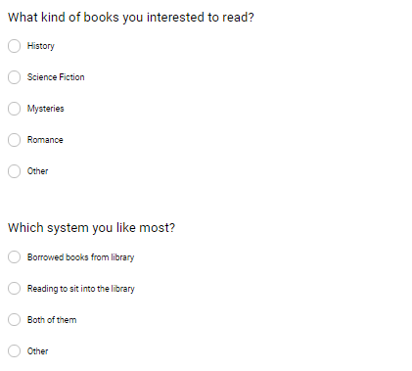
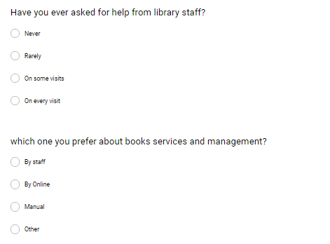
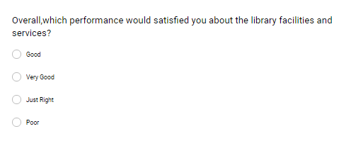
Questionnaires

Slide 10
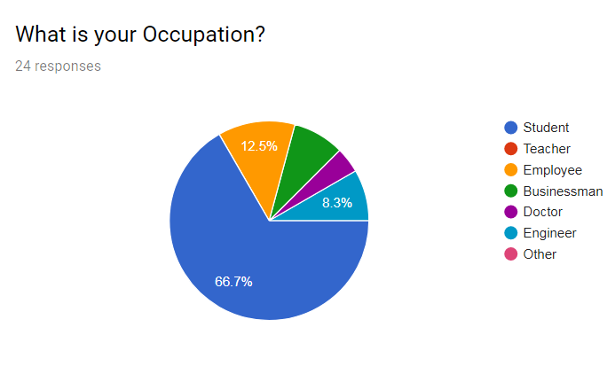
Survey Results (Continued)

Slide 11
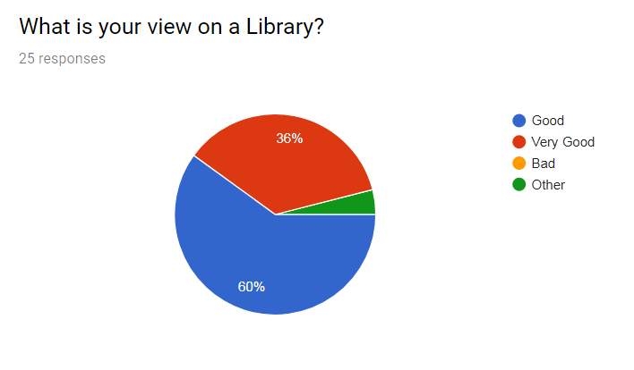
Survey Results (Continued)

Slide 12
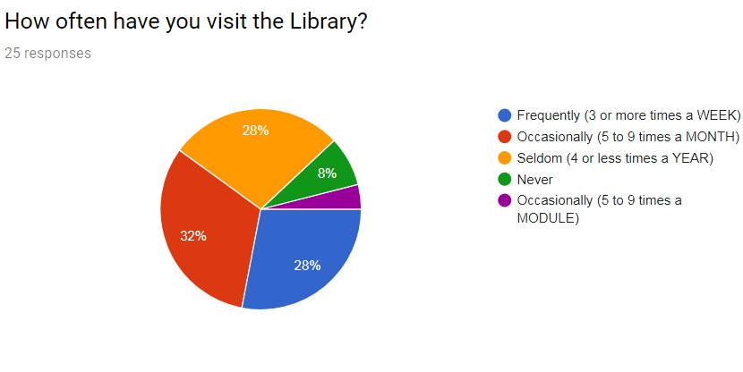
Survey Results (Continued)

Slide 13
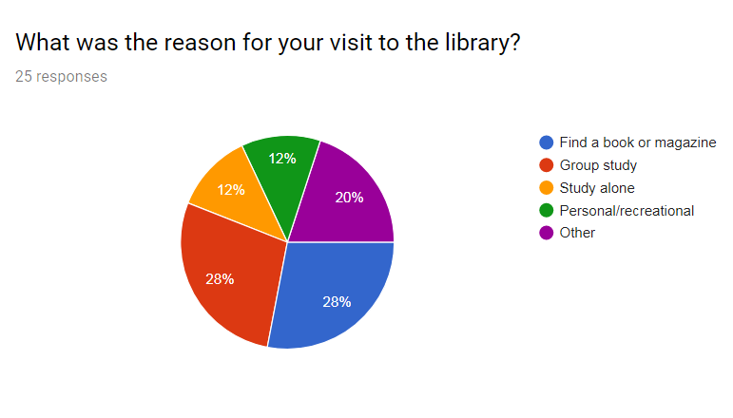
Survey Results (Continued)

Slide 14
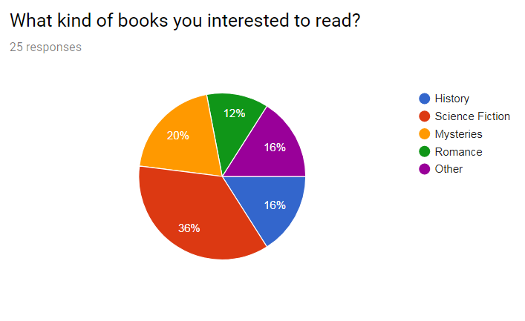
Survey Results (Continued)

Slide 15
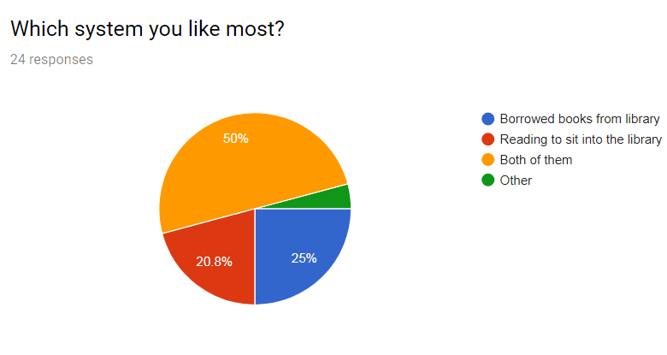
Survey Results (Continued)

Slide 16
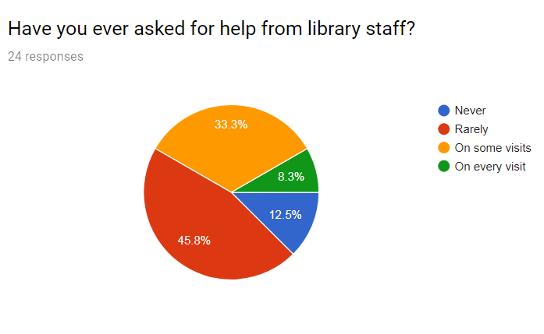
Survey Results (Continued)

Slide 17
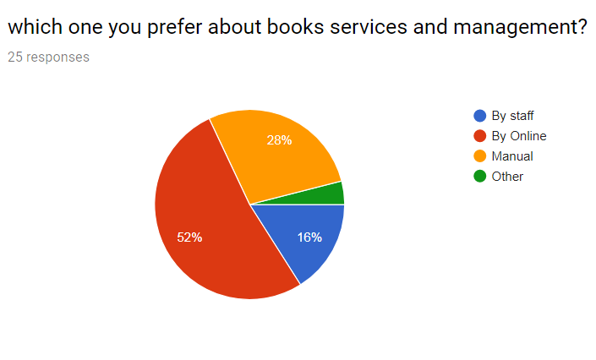
Survey Results (Continued)

Slide 18
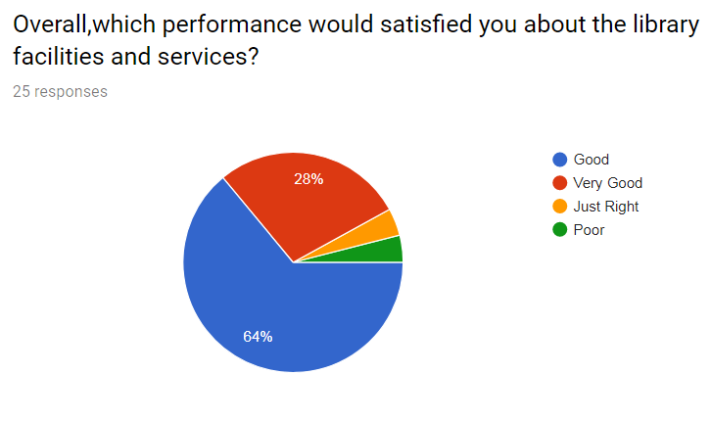
Survey Results (Continued)

Slide 19
Investigation
Benefits to be provided by the system
Gathering Information
Getting Knowledge of the project request
Rough estimation of the costing for the system
Feasibility of development

Slide 20
THANK YOU

